Slide 1
Introduction to Cyber-security
Interests and Careers Paths By: Anthony Langga and Flora Lee

Slide 2

Defending Cyberspace: Are We Ready?
Hot Topic today
Golden Age for Information Assurance /Cybersecurity
Increased reliance on the internet
Consumers embracing mobile solutions

Slide 3
What is cyber-security?
Information Technology Security
Protection of computer systems and data
“protecting computers, networks, programs and data from unintended or unauthorized access, change or destruction.” http://www.umuc.edu/cybersecurity/about/cybersecurity-basics.cfm

Slide 4


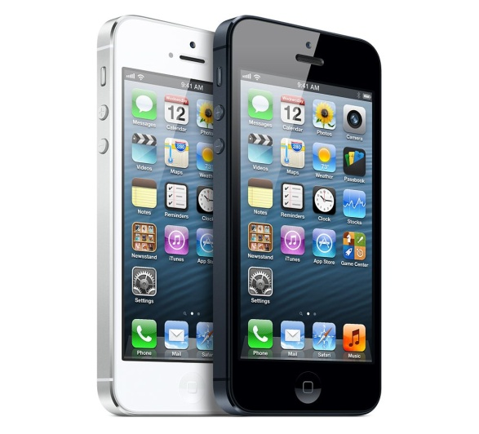
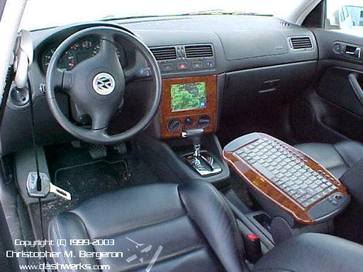
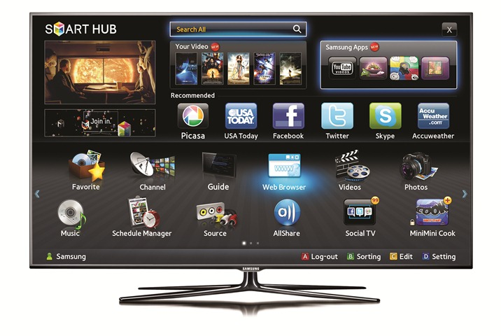
Computers:

Slide 5
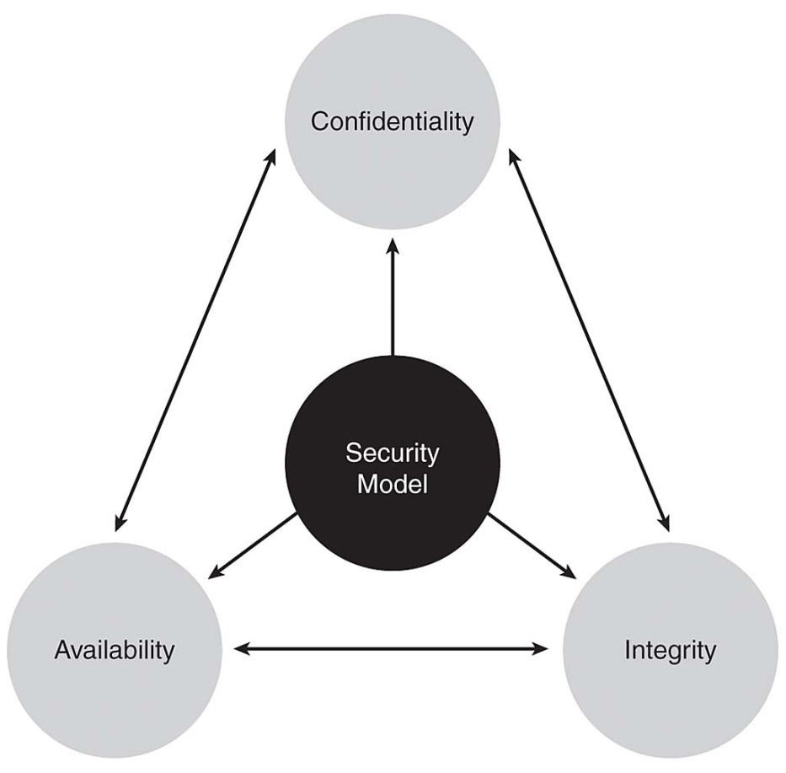
What makes system secure?
Confidentiality
Access to only certain people
Integrity
Data is unchanged
Accessibility
Accessible when needed
en.wikipedia.org/wiki/Information_security‎

Slide 6
Malware
A software that enters a computer system without the user’s knowledge or consent, then performs an unwanted and usually harmful action
What can it do?
Intercept data
Steal information
Launch attacks
Damage a computer’s software

Slide 7
Types of Malware
Rapidly spreads its infection
Virus
reproduces itself on the same computer
Dependent on user for its survival (i.e. user opens a file)
Types: Program/macro/resident/boot/companion virus
Worms
Designed to take advantage of a vulnerability in an application or an OS so it can enter a computer
Conceals its purpose
Trojans
.exe advertised as performing 1 activity, but actually does something else
Rootkits
Set of software tools used by an attacker to hide the actions or presence of other types of malicious software ex. Trojans, viruses, or worms
Backdoor
Software code that gives access to a program or service that circumvents any normal security protections

Slide 8
Types of Malware (cont.)
Making a profit for its creators
Botnets
A program that allows the infected computer to be controlled remotely by an attacker
Spyware
Software that spies on users by collecting information without consent, which violates privacy
Adware
Software program that delivers advertising content in an unexpected and unwanted by the user
Ads, pop-ups, opens a new Web browser window at random times
Keylogger
Remembers each keystroke a user types on their keyboard

Slide 9
Social Engineering Attacks
Most rely on psychology – the mental and emotional approach
Tries to persuade a victim to provide information or take actions
Impersonation – pretending to be someone else
Phishing – sending an e-mail or displaying a Web announcement that falsely claims to be a form of a legit business to trick the user into providing their private information

Slide 10
Types of “Hackers”
Black Hats?
Gray Hats?
Blue Hats?
White Hats?

Slide 11

Black Hats
Violate computer security for personal gain
Steals credit card numbers
Harvesting personal data for sale to identity thieves
Create pure maliciousness attacks
Fit the stereotype of what people believe are “hackers”
Computer criminal

Slide 12

White Hats
Opposite of black hats
“Ethical hackers”
For the greater good, ethical, and legal purposes
Reports back to the organization & informs them on how to better improve their defenses
“Penetration testing”
Some organizations reward those who find a flaw to compensate their work

Slide 13
Gray Hats
Somewhere between a black hat & white hat
Does not work for own personal gain
Nor cause carnage
MAY technically commit crime
MAY do arguably unethical things
Disclose a flaw publicly instead of privately

Slide 14

Blue Hats
A security professional
Invited by Microsoft to find vulnerabilities in Windows
Opposite of White Hat and Black Hat
“Blue” to reflect Microsoft’s corporate color

Slide 15
Types of Jobs
Government / Gov’t Contractor / Private
Application security tester
Security analyst
Penetration tester
Information assurance engineer
Information assurance analyst
Reverse engineer
Malware analyst
Forensics
Incident response
Vulnerability analyst
Vulnerability researcher
Mobile code tester
Program manager
Legal
Developer
Policy & procedure writer
Security architect
Code reviewer
Network security engineer
Technical writer
Notes:
Note:
Not all of these are technical roles, but they need to have some knowledge of networks and/or IT security.
Ex. How to mitigate

Slide 16
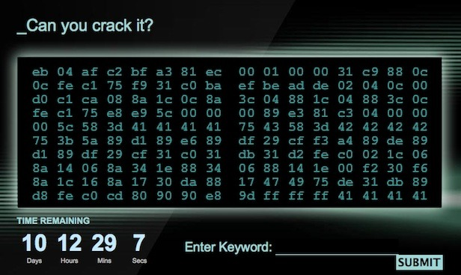
Cryptography
www.webpronews.com

Slide 17
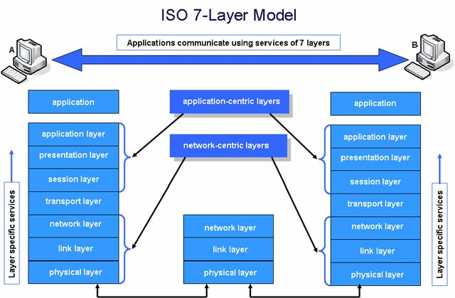
OSI model

Slide 18
How to get in the field
Current job – cross train
Intern
Cyber competitions
Law enforcement
Job fairs
Company websites
Join security groups
Find a mentor
Network
Immerse yourself
(be aggressive)

Slide 19
Path to cyber-security
IT background
Work your way up
helpdesk, system admin, network admin, developer
Education
Degree in Computer Science, Cybersecurity, Forensics, IT
Training – Hands-on (CTFtime.org) Kali/ Backtrack 5
Virtual Machines are your friend
Certificates – A+, Security+, Microsoft, Cisco, CEH…
Patience, persistence, self-motivation

Slide 20
Penetration Testing
CTFtime.org
Metasploitable, Webgoat
Metasploit, Nmap, ncat, Cain, Python/Ruby
Burp Suite, Google
Hackthissite.org
General IT backround

Slide 21
Analysts/Adminstrator
Network, Architects, System admins
Know Technology inside and out
Pentester Boot lab
IT backround (routers, switches, network)
Virtual lab
Wireshark, Nmap/ncat, TCP Dump
Web (PHP, HTML explorts)

Slide 22
Forensics
OllyDbg, IDA Pro, Volatility Mandiant redline
System adminstrations
Assembly, hd5 hashes,
Hexadecimal, ASCII,
Process Monitor, Regishot

Slide 23
Cyber Ethics
Simple attacks can cause billions of dollars of damage
Stealing
Unauthorized Access
Black Hat vs White Hat
Data destruction

Slide 24
Why cyber-security?
“For every engineer, we need a security analyst”
People who can think differently
White hat hackers vs. Black hat Hackers
Stuxnet
Zues
Red October
NSA

Slide 25
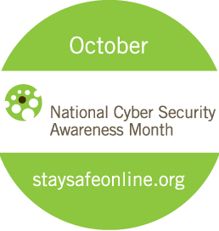
Fun Facts and Misonceptions
October is Cyber Security Awareness Month
“Hacker” ≠ “criminal” or “bad guy”
Only 14% of women are in the InfoSec field (2013)
Oil & gas industry are the current targets for hackers
Brute-force encryption increases as computer hardware becomes faster and faster
More calculations per second
NSA, FBI, Microsoft, Facebook, RSA & many more are recruiting/hiring
Notes:
These random Facts could set the stage for future topics.
Remember the responses of the audience, their reactions, see what they like to learn more, and adjust your lesson plans accordingly.

Slide 26
References
Security+ Guide to Network Security Fundamentals
Securityaffairs.co/wordpress
http://www.howtogeek.com/157460/hacker-hat-colors-explained-black-hats-white-hats-and-gray-hats/
http://www.howtogeek.com/166832/brute-force-attacks-explained-how-all-encryption-is-vulnerable/
www.som.buffalo.edu/isinterface/papers/IEEE%20IT%20Professional.pdf‎
http://youtu.be/BjJkgs1lc6c

Slide 27
Works Cited
http://eofdreams.com/photo/computer/05/
www.connectedaustralia.com
streebgreebling.blogspot.com
en.wikipedia.org
giantbomb.com

